Slide 1
The Solar System

Slide 2
Brainstorming…
Know | Want to learn | Learned
The sun is a giant ball of fire | How many planets are there? | The sun is a star
Pluto is not a planet anymore because someone decide so - poor thing. | What is the biggest planet? | jupiter is the biggest planet, Mars is the red planet, Saturn has big rings
The sun anche the moon orbit around the Earth. | Who is lives there? | The Earth orbits around the sun
The platents are 7 | What is the Sun made of? | The planets are 8

Slide 3
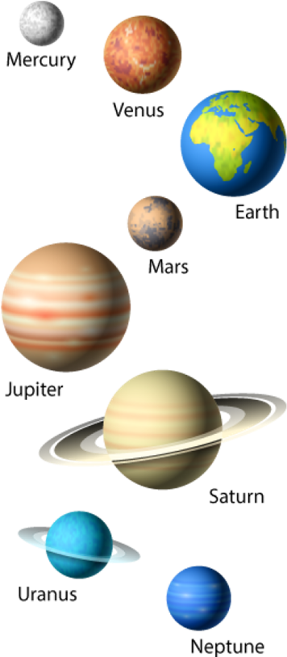
https://www.youtube.com/watch?v=F2prtmPEjOc
https://quizlet.com/it/761476440/the-solar-system-flash-cards/?x=1qqt
IT LAB - Cooperative Learning

Slide 4
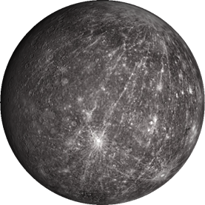
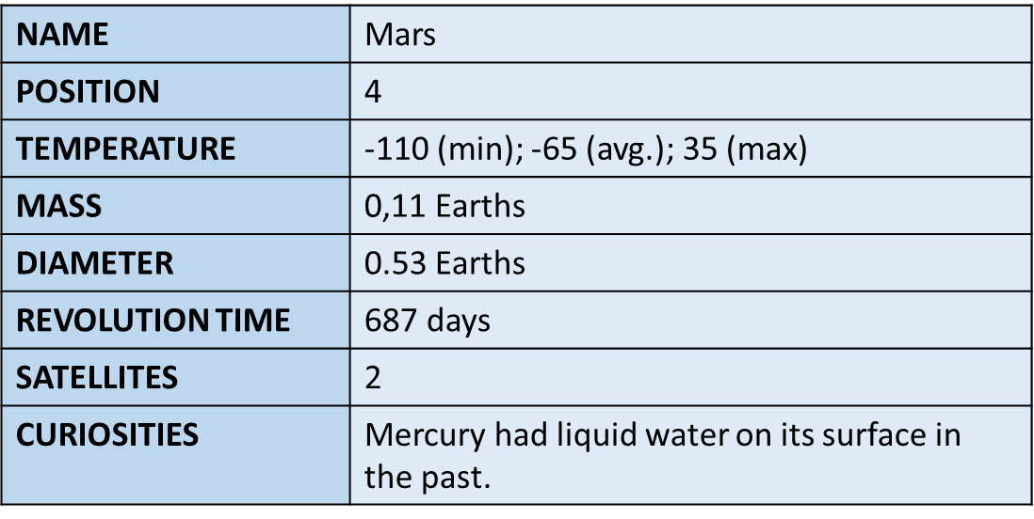
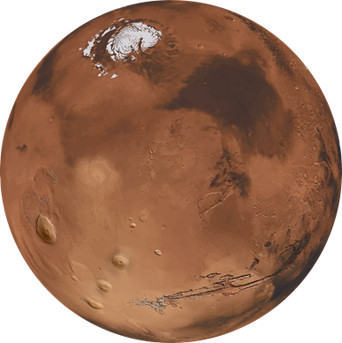
MERCURY
https://spaceplace.nasa.gov/all-about-venus/en/
MARS
https://spaceplace.nasa.gov/all-about-mars/en/

Slide 5
Interactive games
https://wordwall.net/resource/32697782/astronomy/solar-system
https://wordwall.net/resource/4590101/science/the-solar-system

